Slide 1
PROJECT TITLE NyayaSetu – Justice Bridge (eMarketplace for Legal Services)
CSE7101- Capstone Project
Review-1
Batch Number: 47
Under the Supervision of,
Mr.Aadil Ferooz
PrAssistant Professor
School of Computer Science and Engineering
Presidency University
Roll Number | Student Name
20221CSE0467 | Ramalingaiah K R
20221CSE0453 | Guru Kiran V
20221CSE0466 | Hariharan V S
Name of the Program: Computer Science And Engineering
Name of the HoD: Dr. Asif Mohammed
Name of the Program Project Coordinator: Dr. Jayavadivel Ravi
Name of the School Project Coordinators: Dr. Sampath A K , Dr. Geetha A

Slide 2
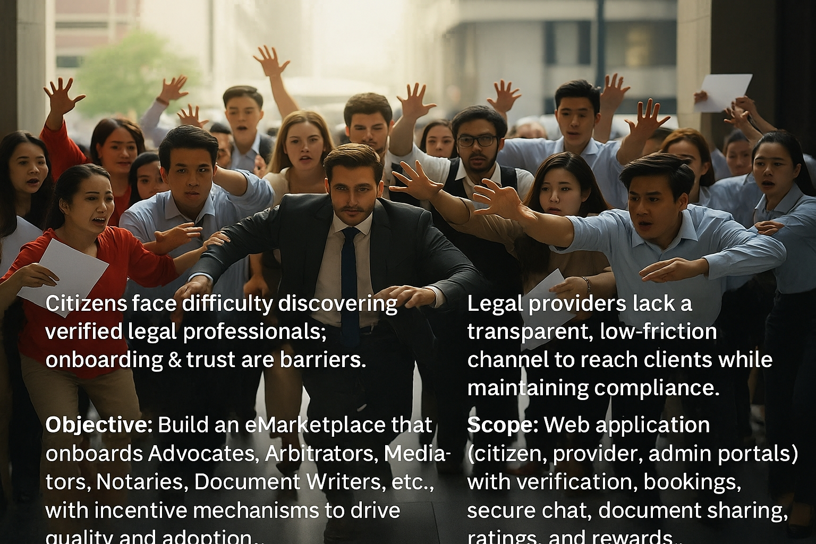

Slide 3
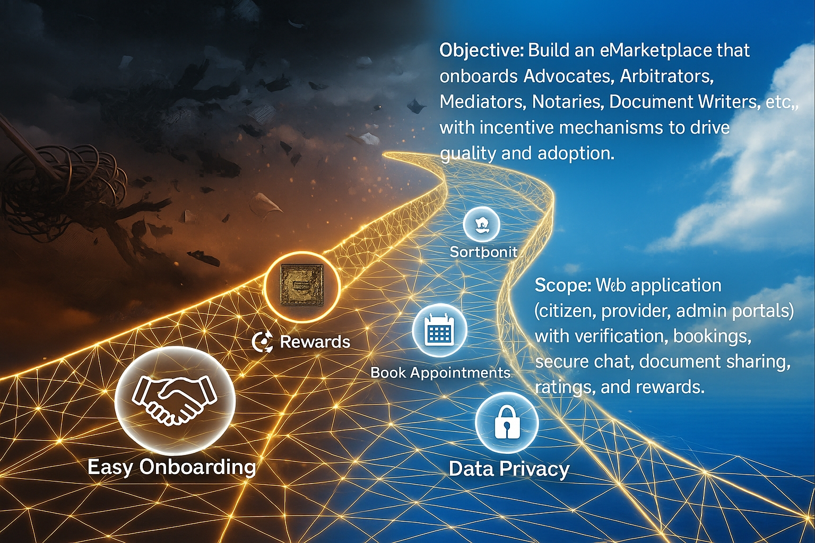

Slide 4
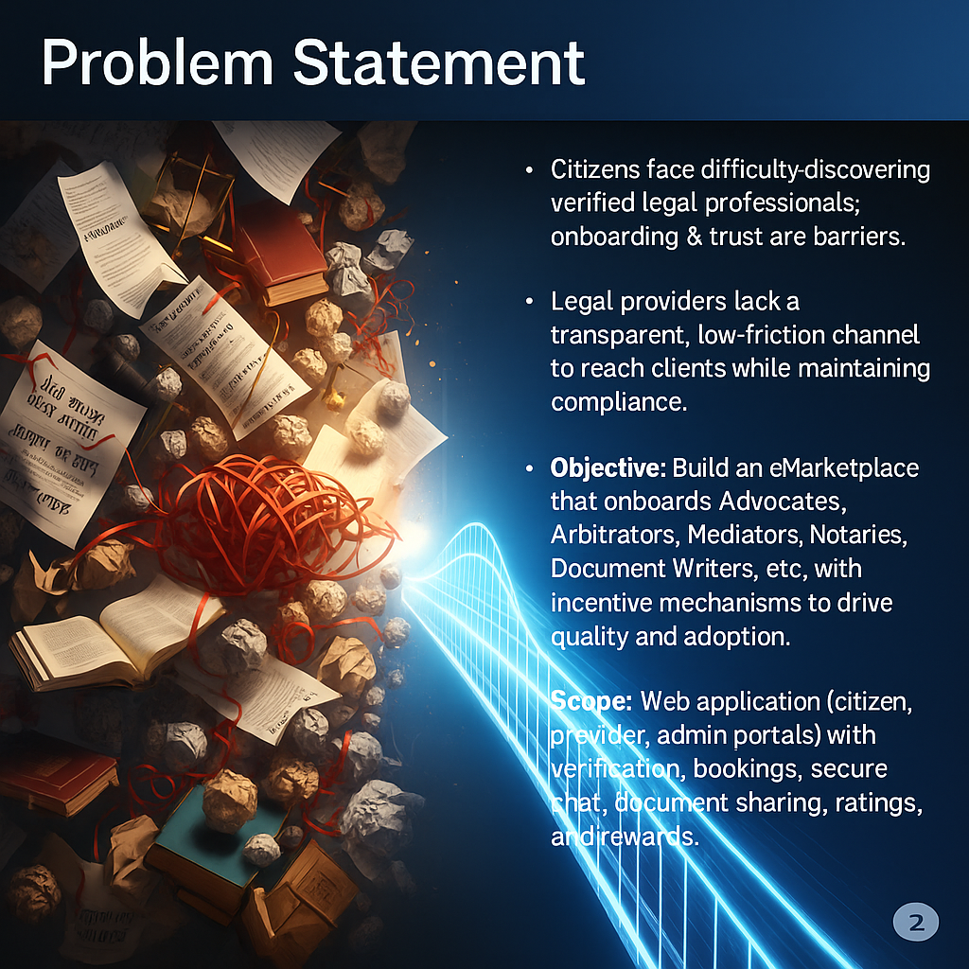

Slide 5
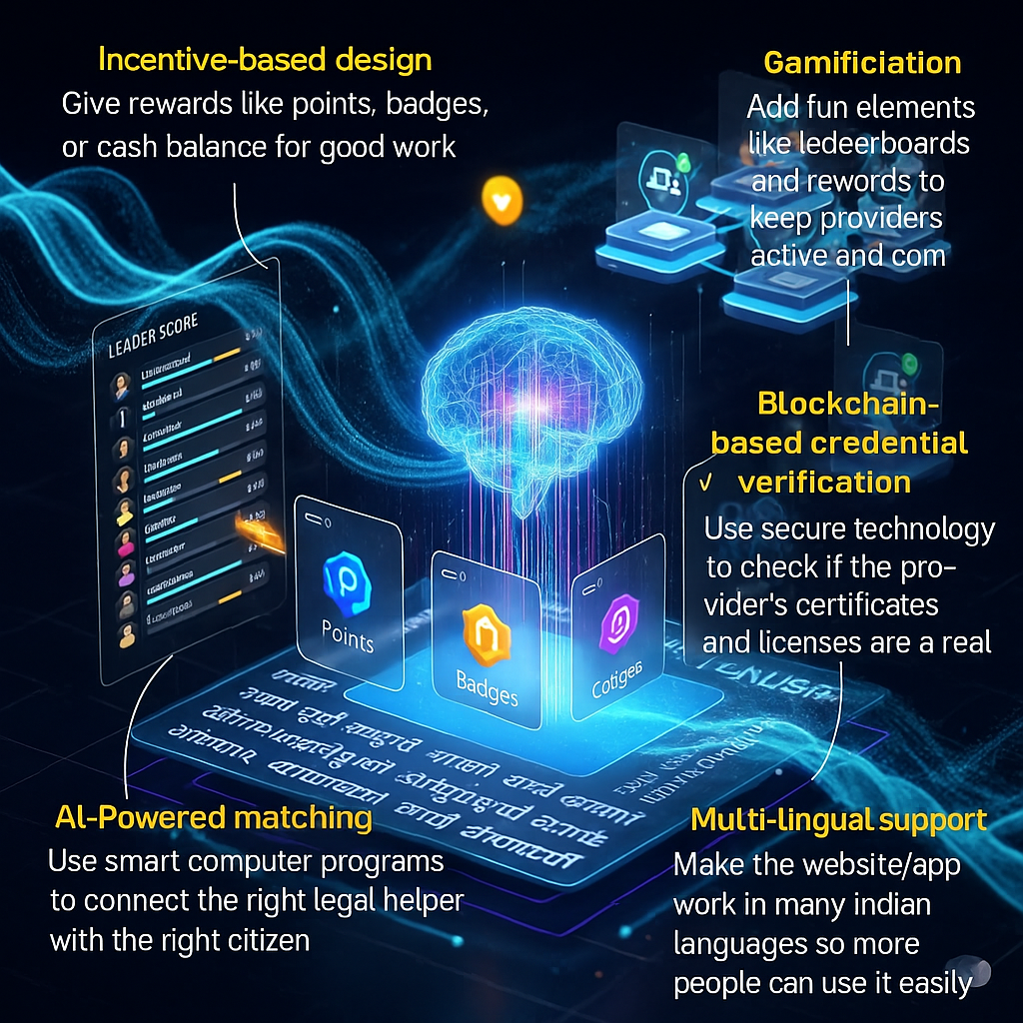

Slide 6
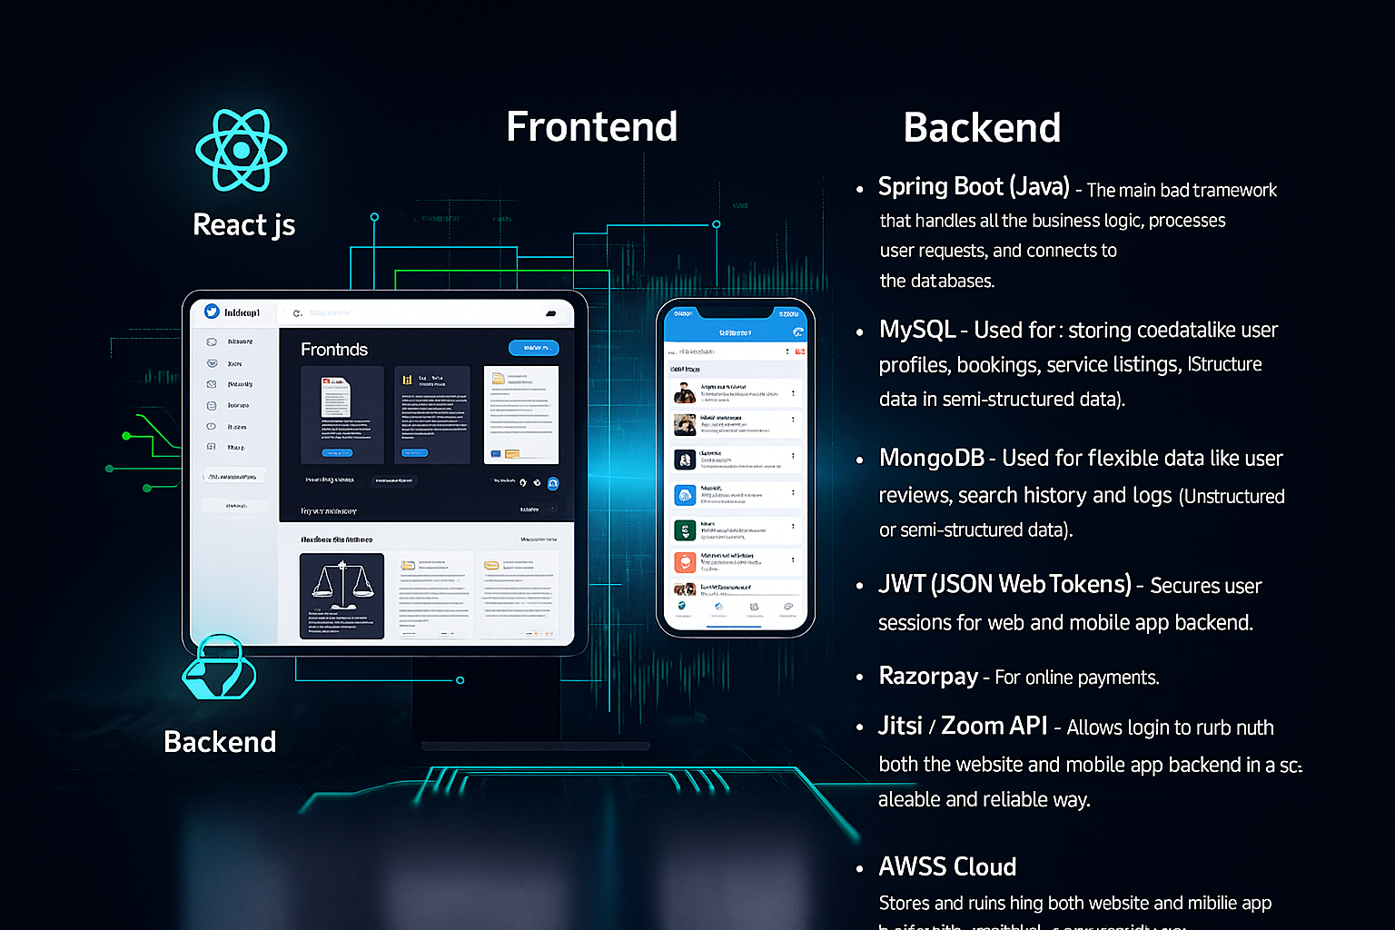

Slide 7
GitHub Link
https://github.com/NyayaSetu/demo (placeholder link).

Slide 8
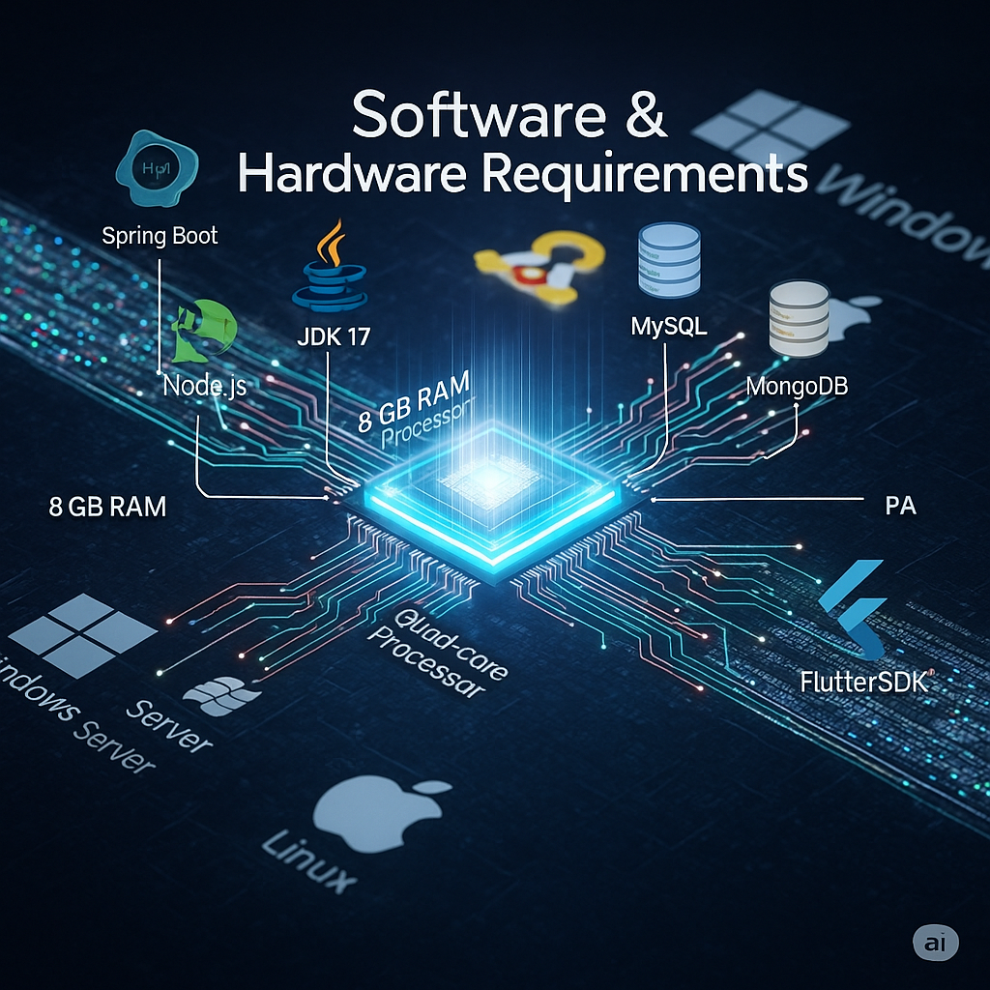

Slide 9
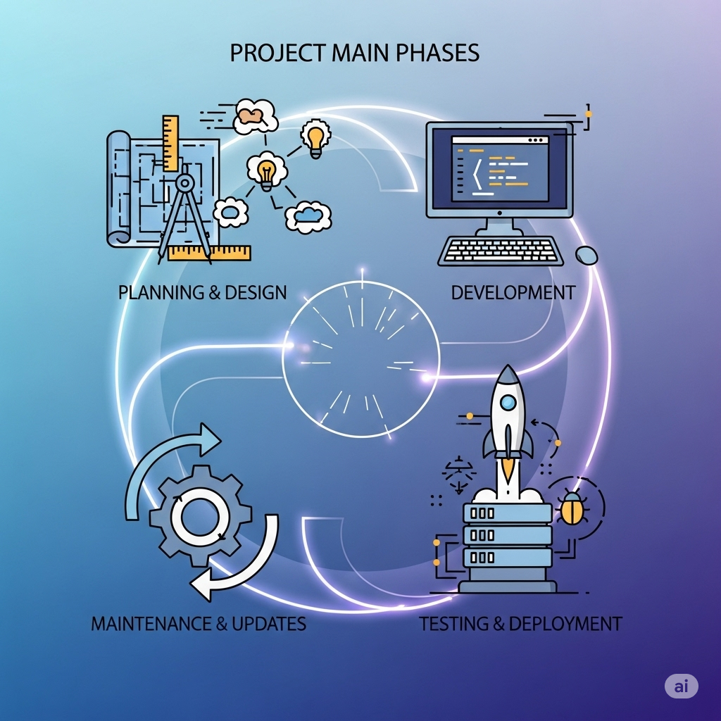

Slide 10
References (IEEE Format)
[1] Oracle, “Java Platform, Standard Edition 17 Documentation,” 2024. [Online]. Available: https://docs.oracle.com/javase/17/
[2] Node.js Foundation, “Node.js v20.x Documentation,” 2024. [Online]. Available: https://nodejs.org/en/docs
[3] MySQL, “MySQL 8.0 Reference Manual,” Oracle, 2024. [Online]. Available: https://dev.mysql.com/doc/
[4] MongoDB, “MongoDB Manual,” MongoDB Inc., 2024. [Online]. Available: https://www.mongodb.com/docs/
[5] Pivotal Software, “Spring Boot Reference Documentation,” 2024. [Online]. Available: https://spring.io/projects/spring-boot
[6] Google, “Flutter Documentation,” Google Developers, 2024. [Online]. Available: https://docs.flutter.dev/
[7] Razorpay, “Razorpay API Documentation,” 2024. [Online]. Available: https://razorpay.com/docs/
[8] Jitsi, “Jitsi Meet API Reference,” 2024. [Online]. Available: https://jitsi.github.io/handbook/docs/dev-guide/dev-guide-iframe
[9] Amazon Web Services, “AWS Cloud Documentation,” 2024. [Online]. Available: https://docs.aws.amazon.com/
[10] S. Nakamoto, “Bitcoin: A Peer-to-Peer Electronic Cash System,” 2008. [Online]. Available: https://bitcoin.org/bitcoin.pdf
If you want, I can prepare a final ready-to-insert “References” section

Slide 11
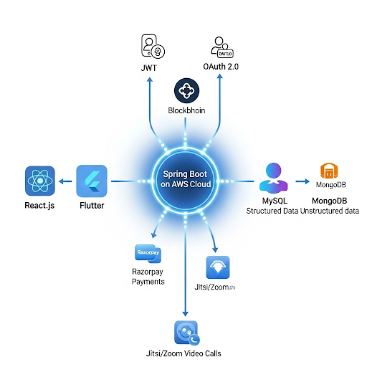

Slide 12
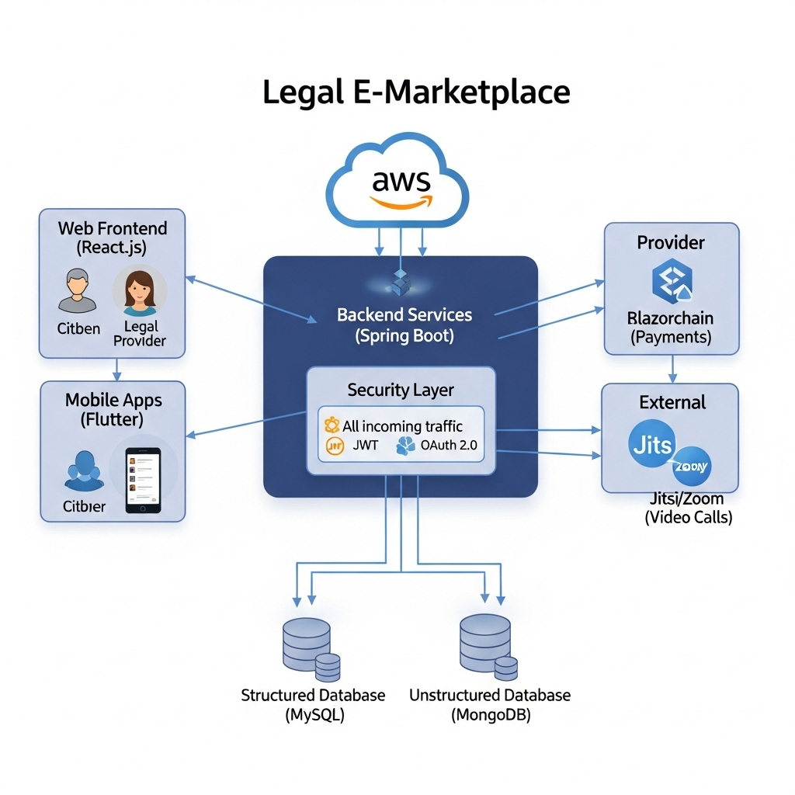

Slide 13


